Slide 1
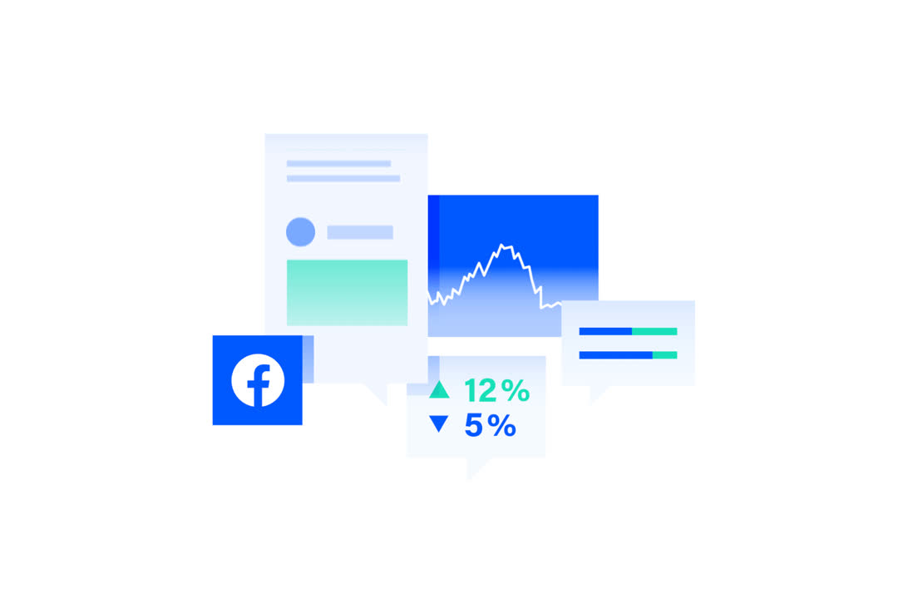
THE DATA WORLD
A GUIDE TO START YOUR CAREER JOURNEY

Slide 2

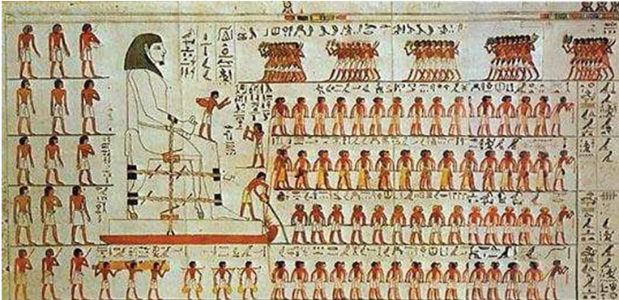

IT IS THE FUTURE OF DATA..
"The use of data dates back millions of years, shaping the progress of ancient civilizations from tracking the stars to building the pyramids. Today, with the rise of AI and advanced technologies, data is more powerful than ever. The future belongs to those who can understand, analyze, and harness it
THE DATA ARCHITECTS OF TOMORROW!"

Slide 3
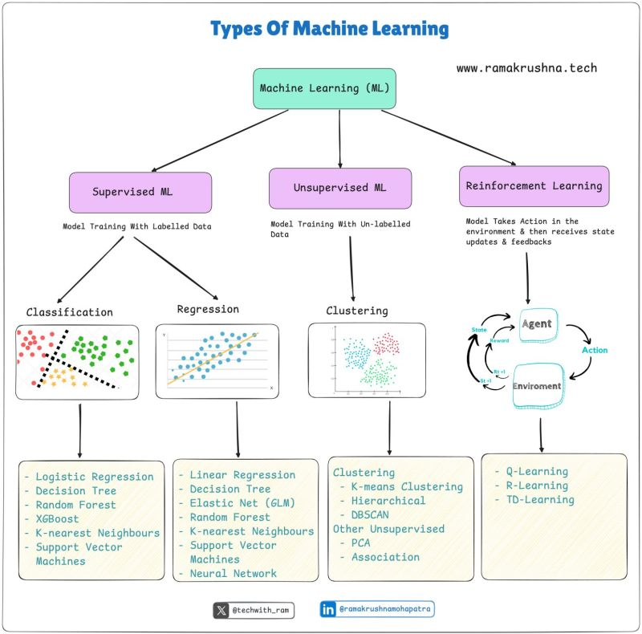

Slide 4
IT IS NOT ABOUT AUTOMATION, IT IS ABOUT THE INDIVIDUALS WHO AUTOMATE IT!
From 09/01/2021 to 10/04/2021, Kaggle conducted its 5th annual industry-wide survey in providing a truly comprehensive view of the state of data science and machine learning and related feilds.

Slide 5

CONTENTS
01
EXPLORING DEMOGRAPHICS, TRENDS
02
WORKFLOW
03
MACHINE LEARNING
04
SUMMARY AND CONCLUSION

Slide 6
KEY FIGURES
25,974
43
1/3
NUMBER OF RESPONDENTS
NUMBER OF QUESTIONS IN THE SURVEY
OF PARTICIPANT ARE DATA SCIENTIST AND MACHINE LEARNING ENGINEERS

Slide 7
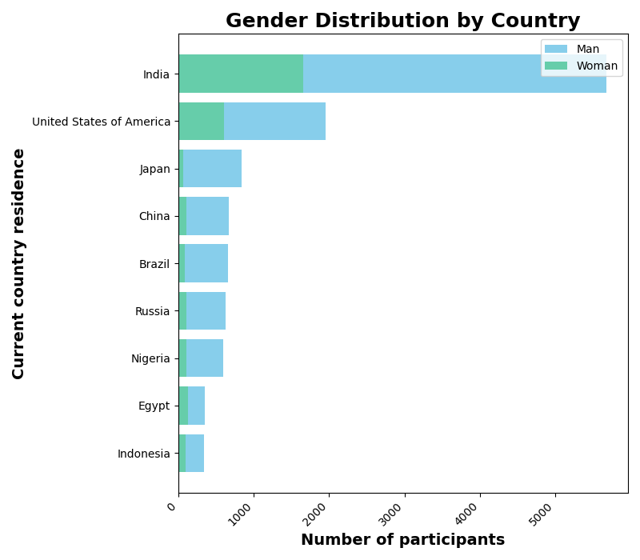
1.1🗺️ COUNTRY/ GENDER DISTRIBUTIONS🗺️
01.

Slide 8
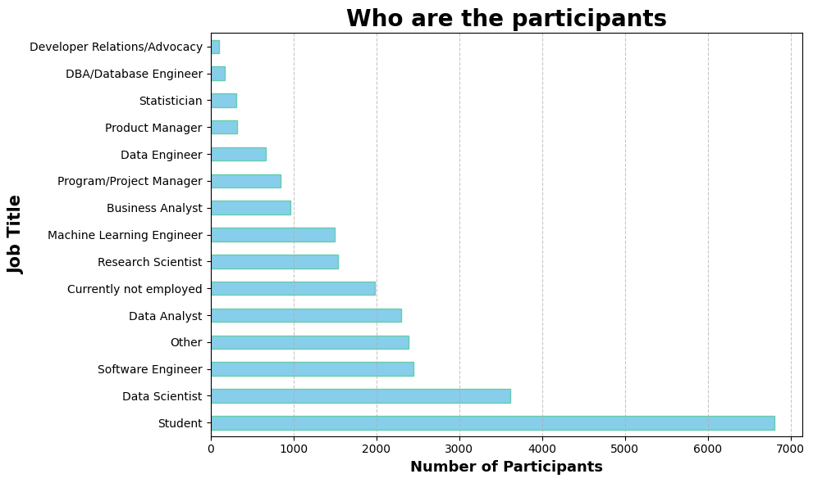
1.2 WHO ARE OUR PARTICPANTS?
01.

Slide 9
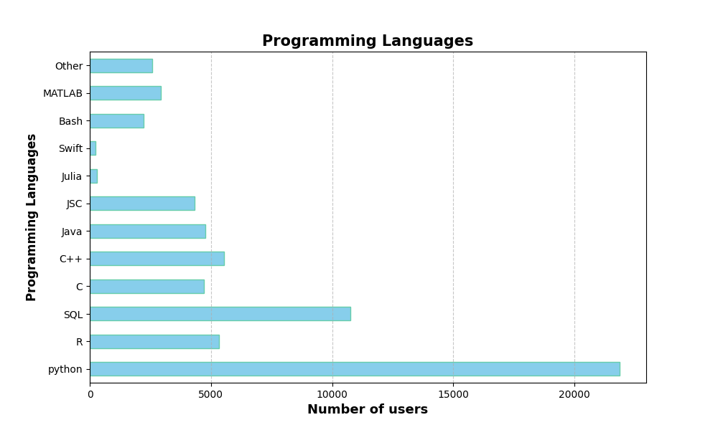
1.3 WHAT ARE THE PROGRAMMING LANGUAGES USED ON REGULAR BASIS?
01.
@CANVACORP

Slide 10
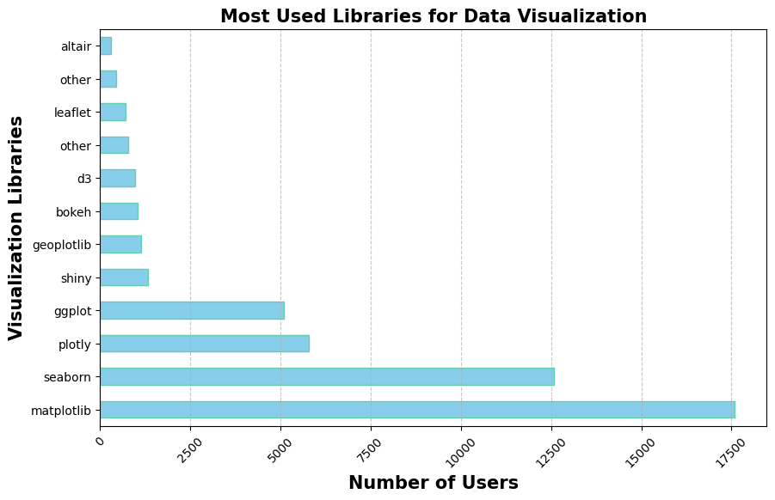
1.4🗺️ WHAT ARE THE MOST USED LIBRARIES FOR VISUALIZATION🗺️
01.

Slide 11
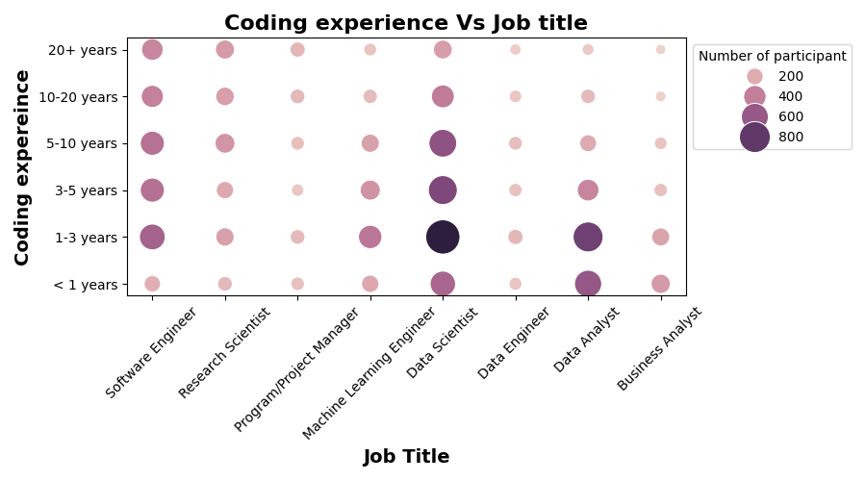
2.1 HOW MANY YEARS OF EXPERIENCE ARE REQUIRED FOR EACH JOB TITLE🎯
02.
The majority of respondents have 1-3 year of experience,💡.
Data science particpant's experience peaks at 3-10 years of coding experience
Most of the Software Engineer participants are professionals in coding..

Slide 12
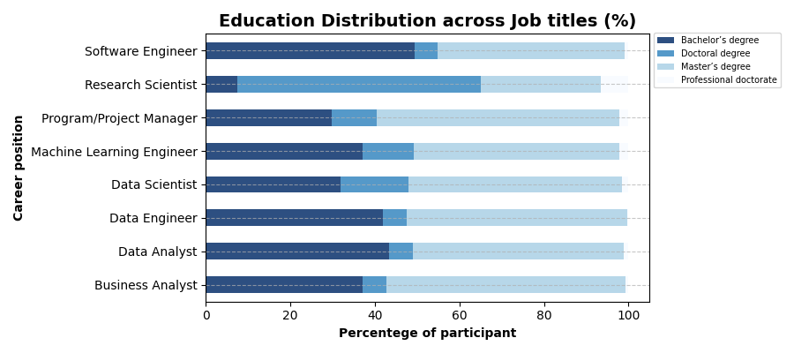
2.2 WHAT ARE THE EDUCATIONAL BACKGROUNDS OF PARTICIPANTS👩🏻‍🎓🧑🏻‍🎓
02.
Seems like becoming a machine learning engineer or a data scientist does not necessarily require a Master degree!
Data engineer, Business analyst, and project manager jobs have large number of participants with masters degree, more than the bachelor's..
If you want to become a research scientist, large opportunities are for ones who earned their doctorate!

Slide 13
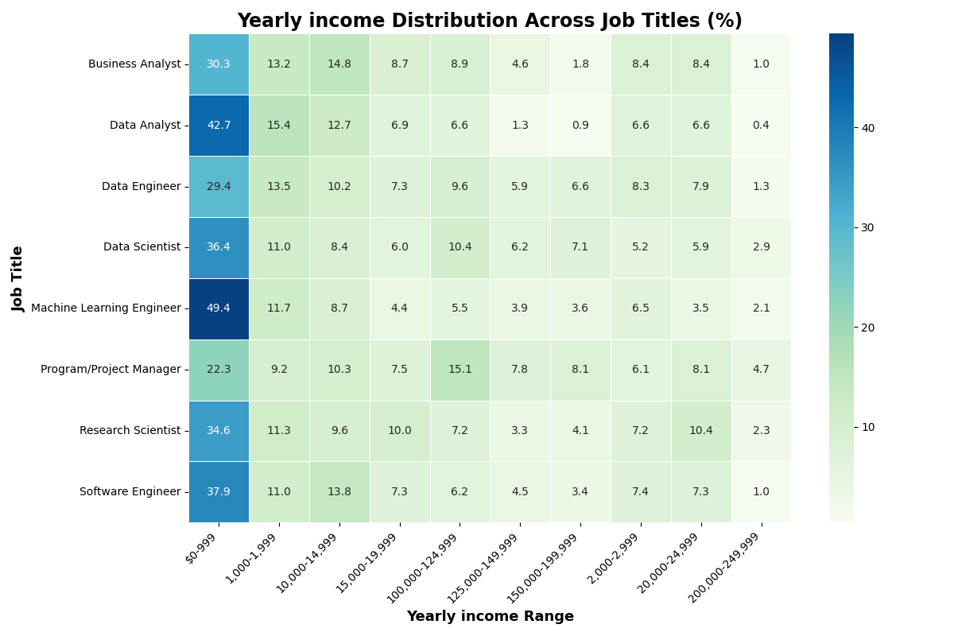
2.3 YEARLY INCOME X JOB TITLES, WHO EARNED MORE 💰?
02.
Machine Learning Engineers tend to have the highest percentage of employees in lower salary ranges! This suggests that entry-level roles in these fields may be more common. 💼📊
Product Managers show a relatively higher percentage in the mid salary ranges, indicating that this role may have fewer entry-level positions and a higher earning potential over time. Similarly, Data Scientists and Software Engineers exhibit a more balanced distribution across salary ranges.

Slide 14
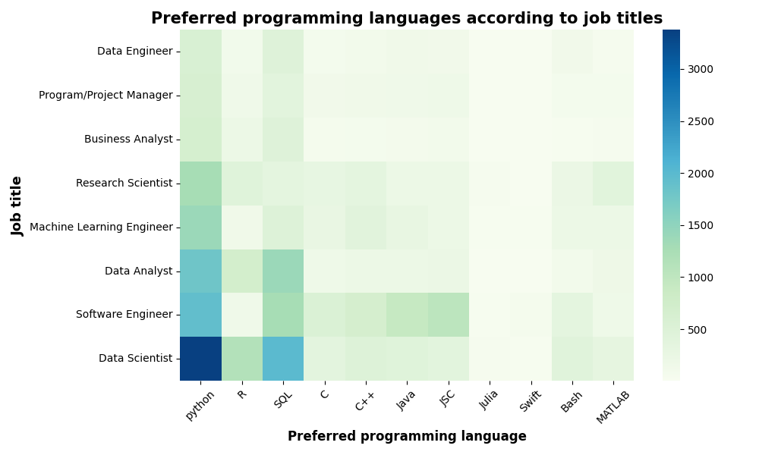
2.4 HOW DO PROGRAMMING LANGUAGES PREFERENCES VARY BASED ON JOB TITLES🤔?
02.
1. Python users are mostly (Students, Data Scientists, and Software Engineers).
2. SQL is mostly used by (Students, Data Scientists, and Data Analysts).
3. C++ is also used mostly by Students.

Slide 15
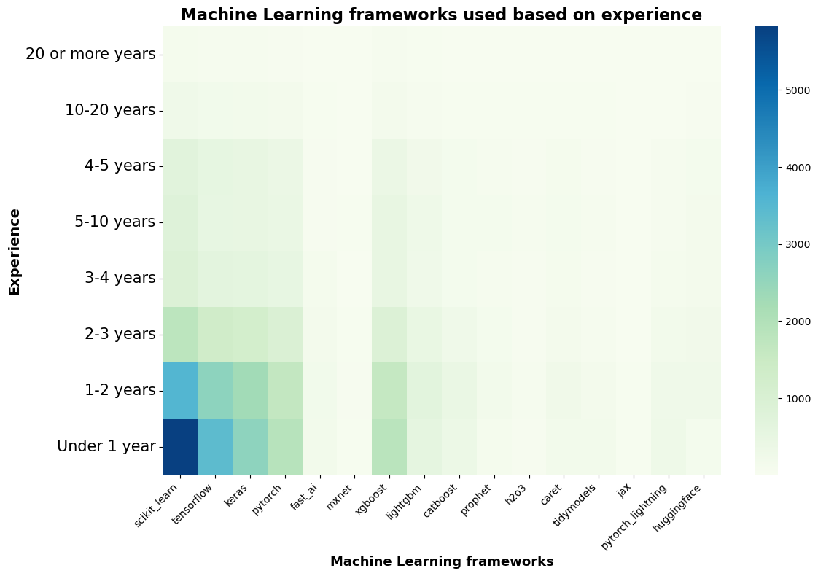
3.1 MACHINE LEARNING FRAMEWORKS
03.

Slide 16
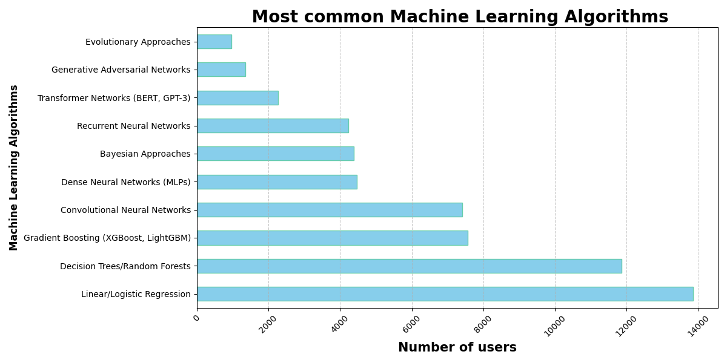
3.2 MACHINE LEARNING ALGORITHMS
03

Slide 17
CONCLUSION: REMARKS
Our analysis provide an overview of the state of data science, machine learning feild in the year 2021.
There is a huge gender gap with ratio of 20:80, where most of the participant are from US and india.
Python users are mostly (Students, Data Scientists, and Software Engineers).
SQL is mostly used by (Students, Data Scientists, and Data Analysts)
Linear/ Regression is the mother of the Machine learning algorithms.
The majority of respondents have 1-3 year of coding experience. Participants of different background experience vary from profession in coding to beginners.

Slide 18
FUTURE WORKS
adding more data from other surveys or reports to compare trends over time.
people's opinions on the frameworks and languages they use
analysis on specific job titles or exploring a specific subcategory

